Slide 1
LARGE EVS PARKING LOT EVS COMPARATIVE STUDY RESULTS

Slide 2
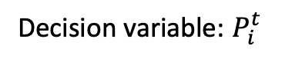
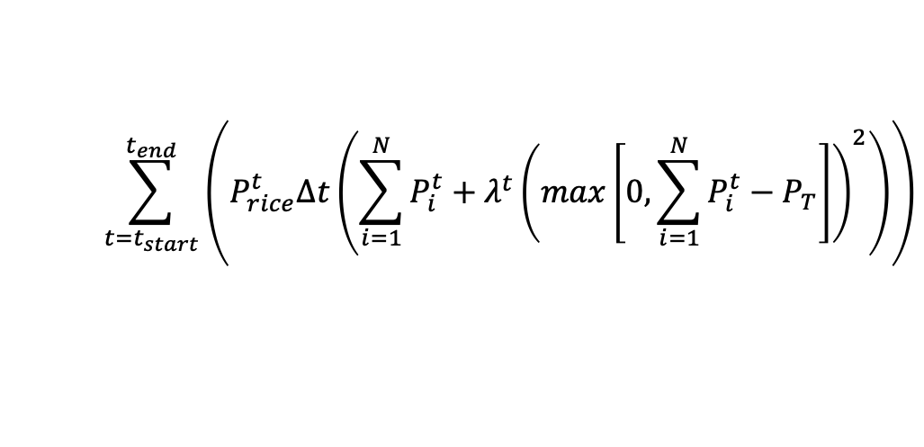


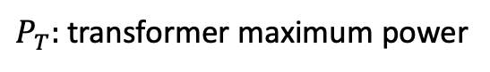
First come first served Charging
$$\sum_{t=t_{start}}^{t_{end}}{\left(P_{rice}^{t}Δt\left(\sum_{i=1}^{N}{P_{i}^{t}}+λ^{t}{\left(max\left[0,\sum_{i=1}^{N}{P_{i}^{t}}−P_{T}\right]\right)}^{2}\right)\right)}$$
Decision variable: $P_{i}^{t}$
$P_{T}:$ transformer maximum power
$N$: Total number of EVs
$λ^{t}$ penalty
First come first served scheduling
Price dependent: charge mostly at lowest price
No discharging, healthy battery
Prolonged waiting time when transformer maximum power reached

Slide 3
Case study structure
The use of Evolutionary algorithm for EVs scheduling in general
In term of speed, differential evolution leads the caravan of evolutionary algorithms
Referee: First come first served Charging
Two criteria of comparison
Algorithm speed
Achievable charging cost
Time slot 5 minutes allows rapid scheduling of new coming vehicles
Conclusion
The optimal cost obtained by DE-based algorithm is not better than that of MILP.
MILP-based smart charging algorithm is much faster than DE method, saving about 85% CPU time, which is a pivotal issue for the real-world application.

Slide 4
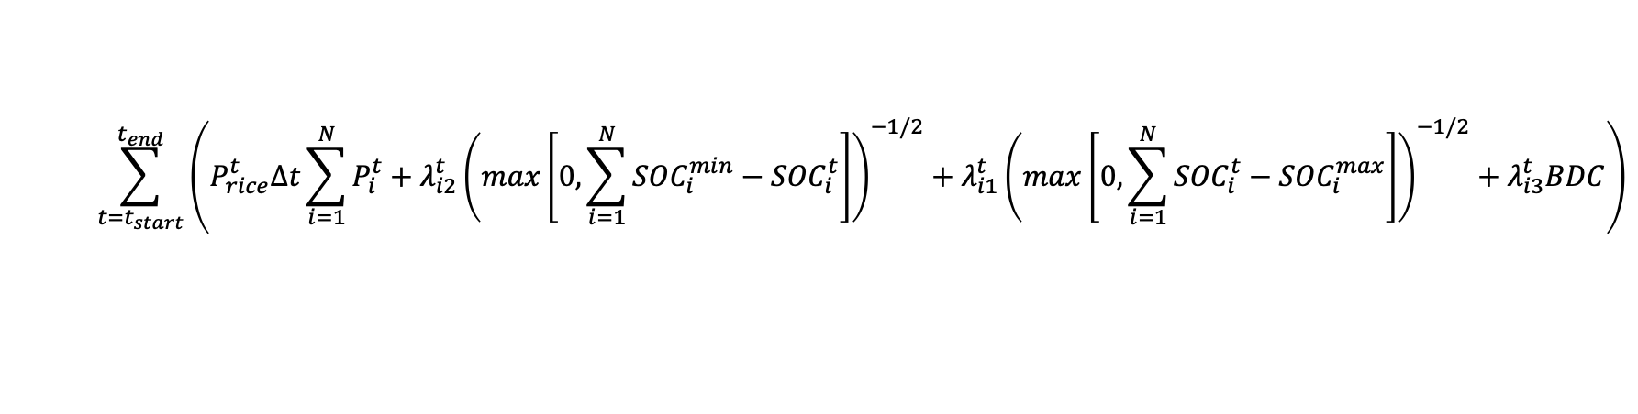
Greedy Charging
$$\sum_{t=t_{start}}^{t_{end}}{\left(P_{rice}^{t}Δt\sum_{i=1}^{N}{P_{i}^{t}}+λ_{i2}^{t}{\left(max\left[0,\sum_{i=1}^{N}{{SOC}_{i}^{min}}−{SOC}_{i}^{t}\right]\right)}^{−1/2}+λ_{i1}^{t}{\left(max\left[0,\sum_{i=1}^{N}{{SOC}_{i}^{t}}−{SOC}_{i}^{max}\right]\right)}^{−1/2}+λ_{i3}^{t}BDC\right)}$$
Profit oriented charging
Least charging cost
Battery degradation included
Desired SOC not guaranteed

Slide 5
Ideal Charging profile
Greedy and uncoordinated combined
Lowest charging cost
Needed SOC satisfied

Slide 6
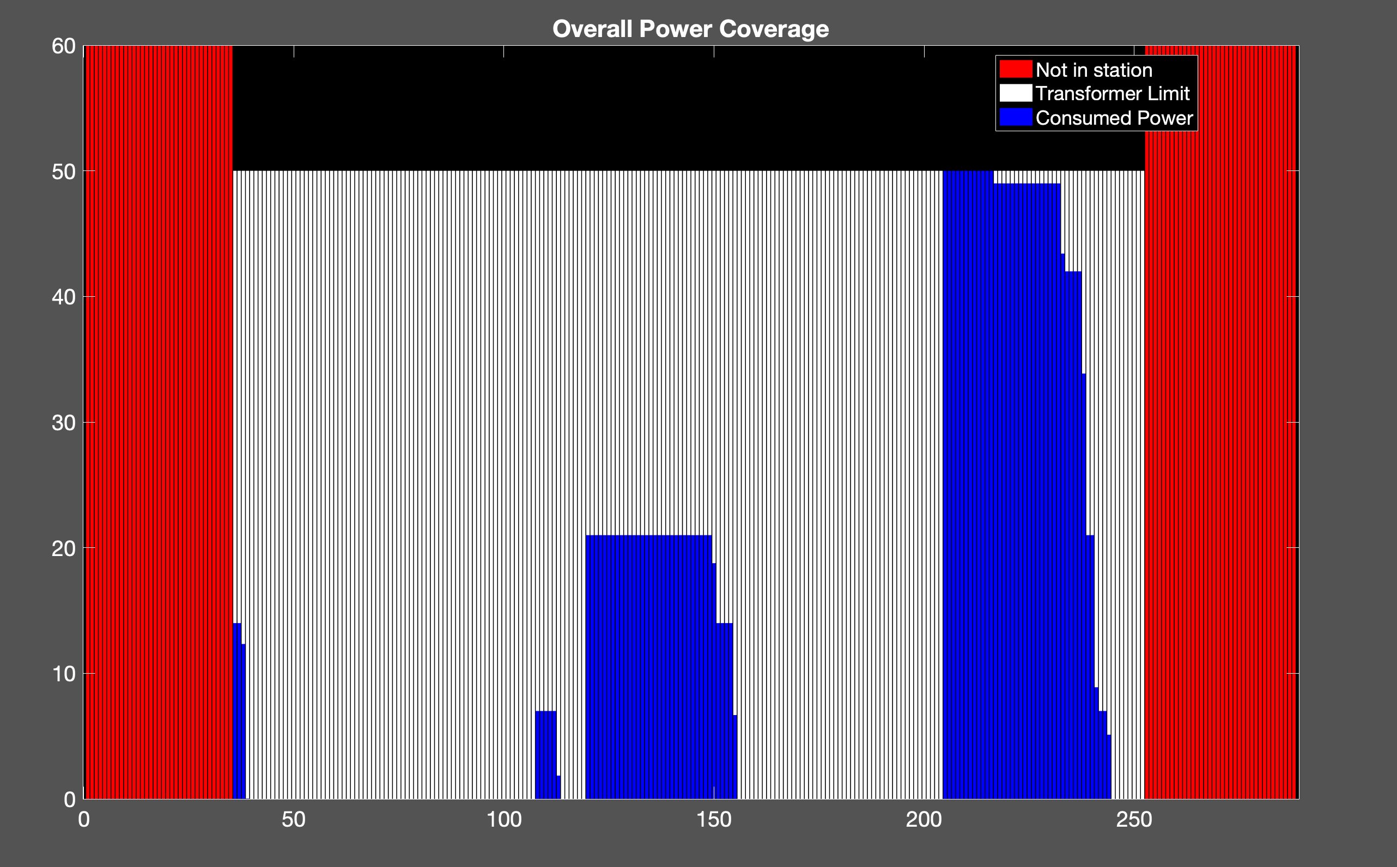
Uncoordinated Charging
10 EVs
Cost: 470.73 NT
Transformer: 50 kW

Slide 7
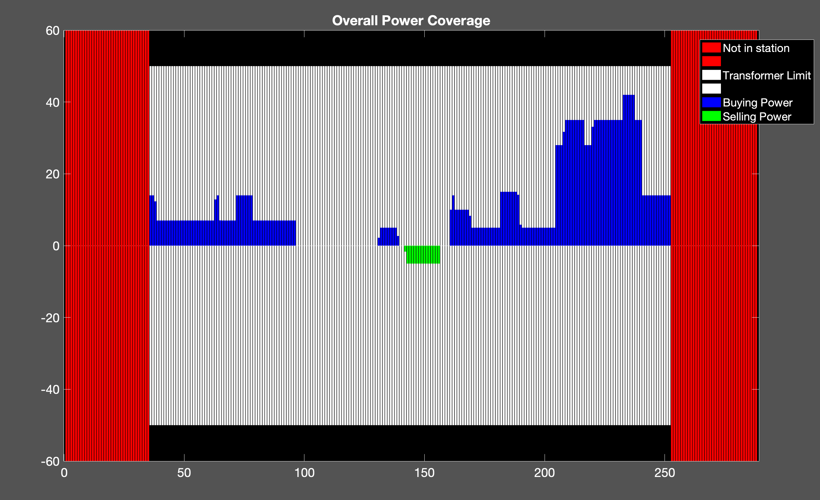
Proposed Method
10 EVs
Cost: 441.08 NT
Transformer = 50 kW

Slide 8
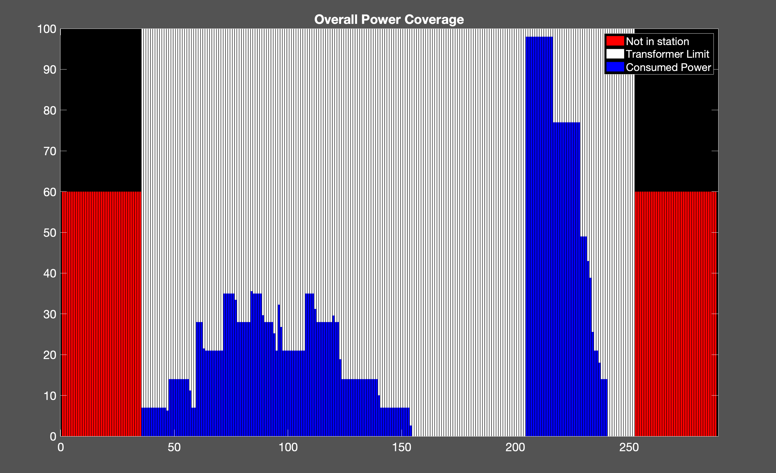
Uncoordinated Charging
20 EVs
Cost: 838.82 NT
Transformer : 100 kW

Slide 9
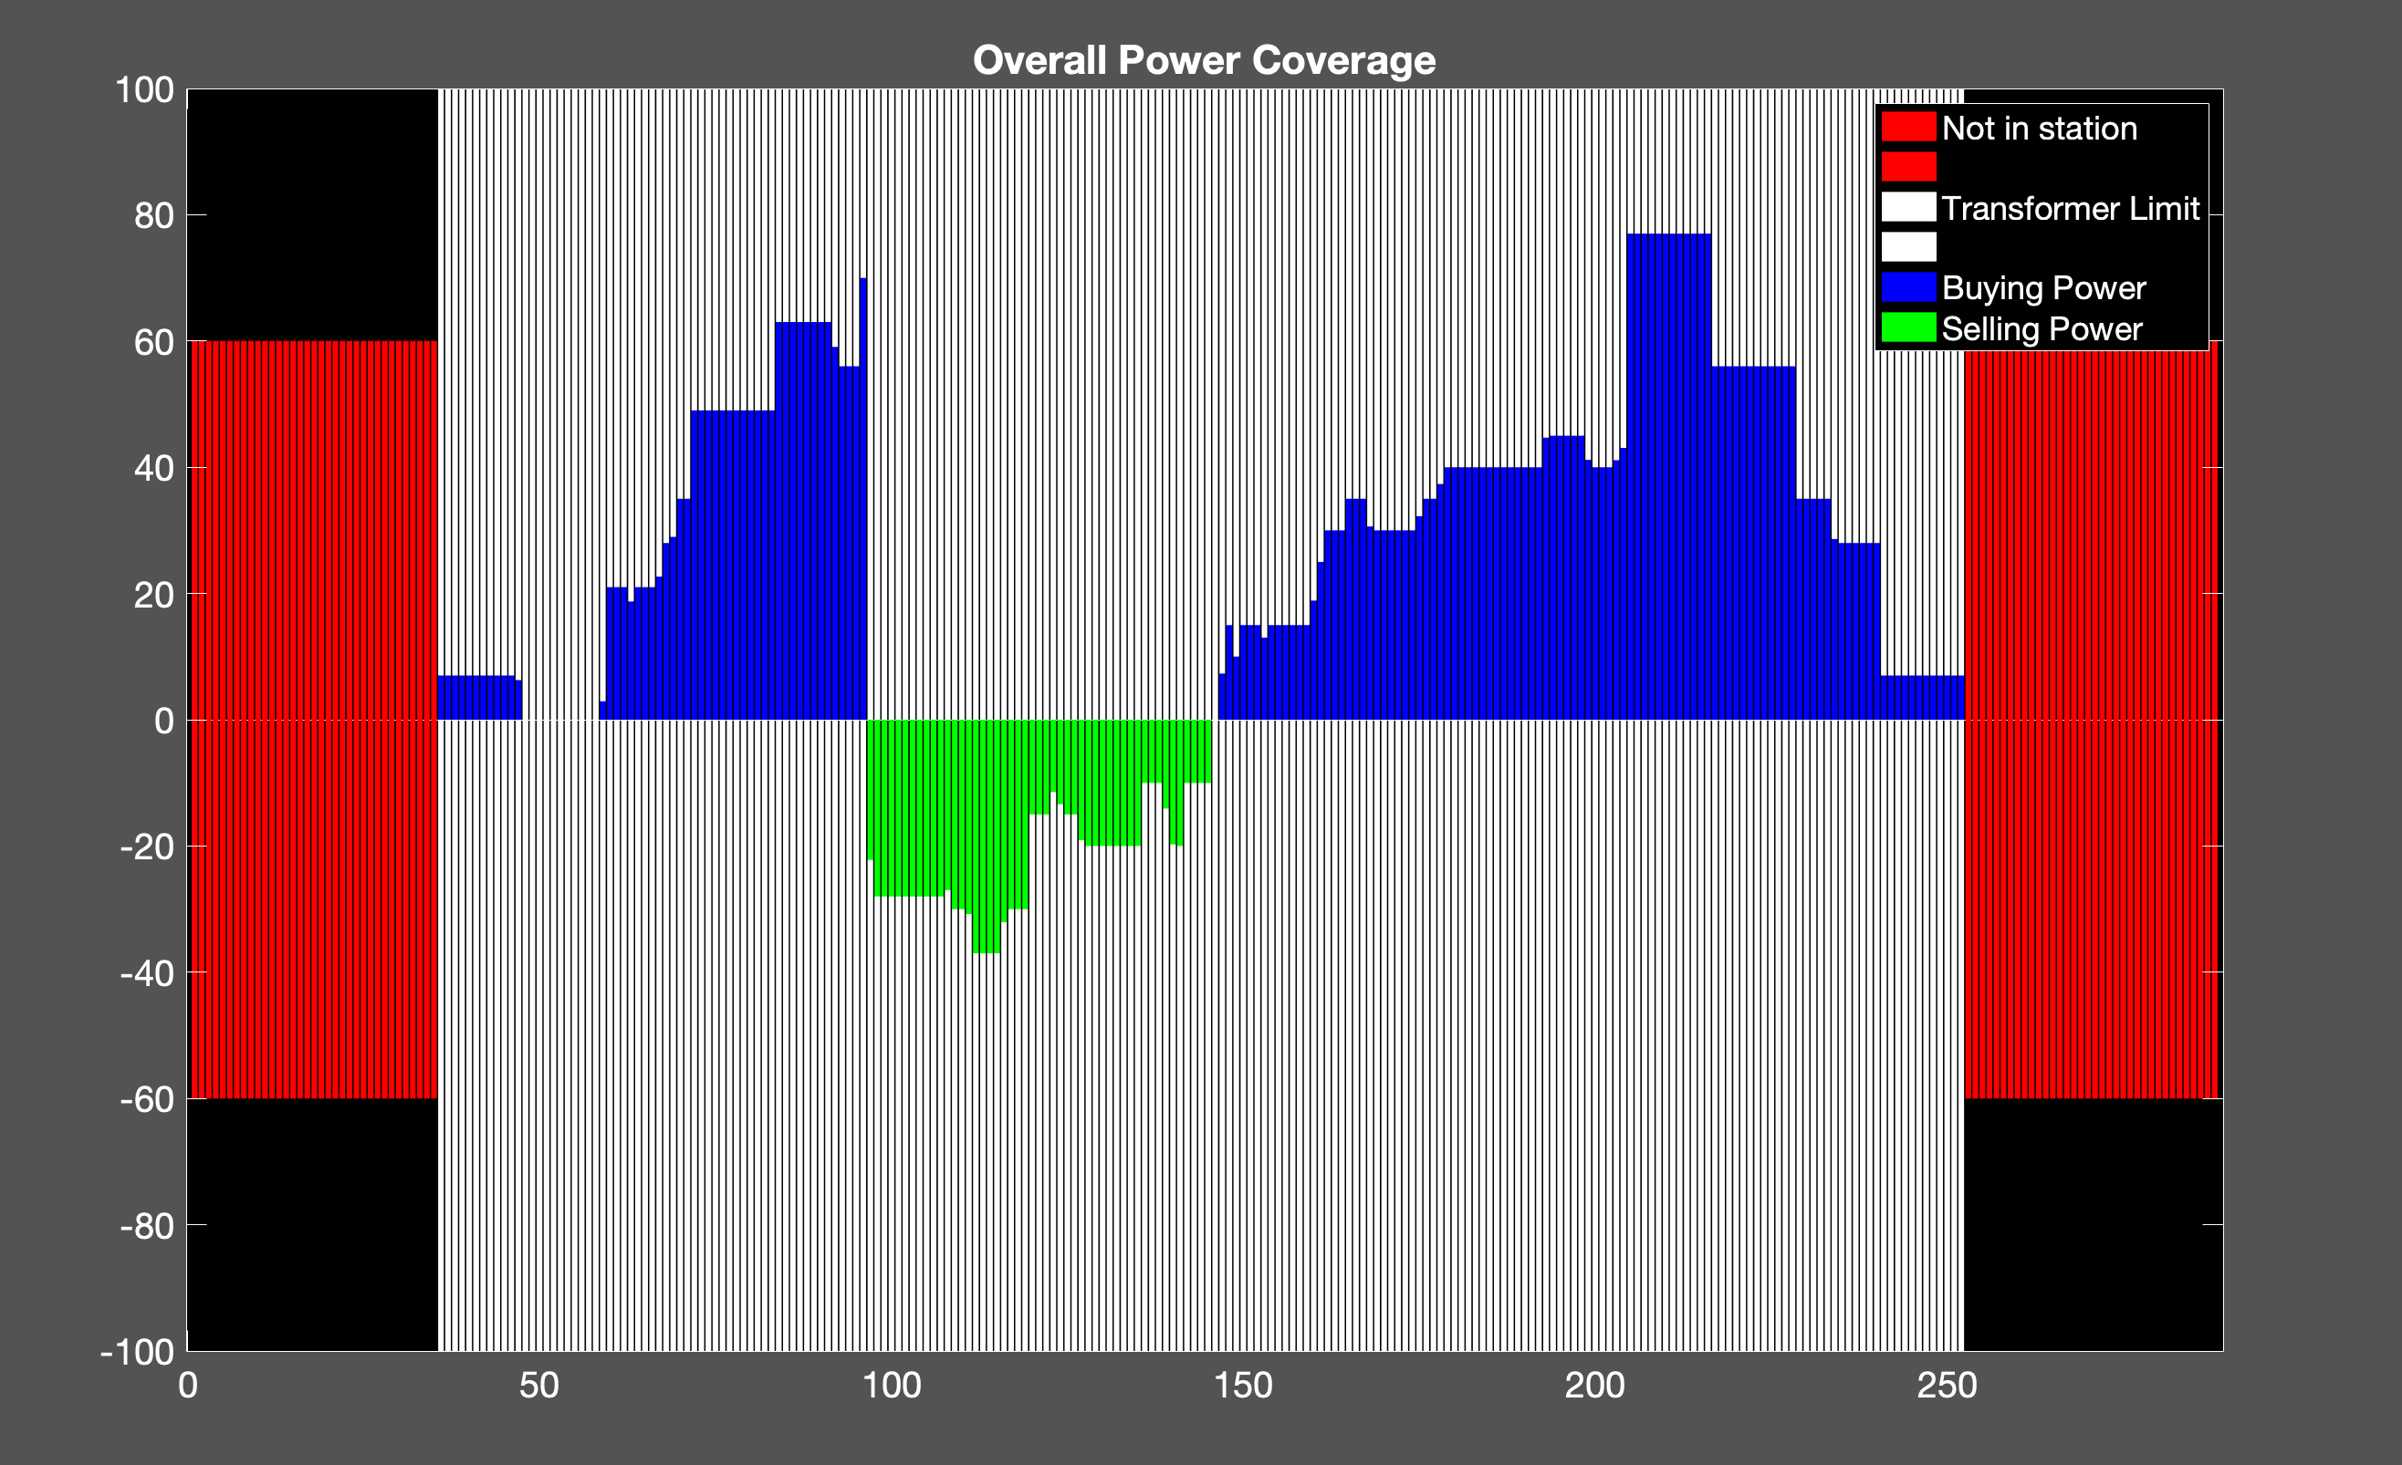
Proposed Method
20 EVs
Cost: 793.03 NT
Transformer: 100 kw

Slide 10
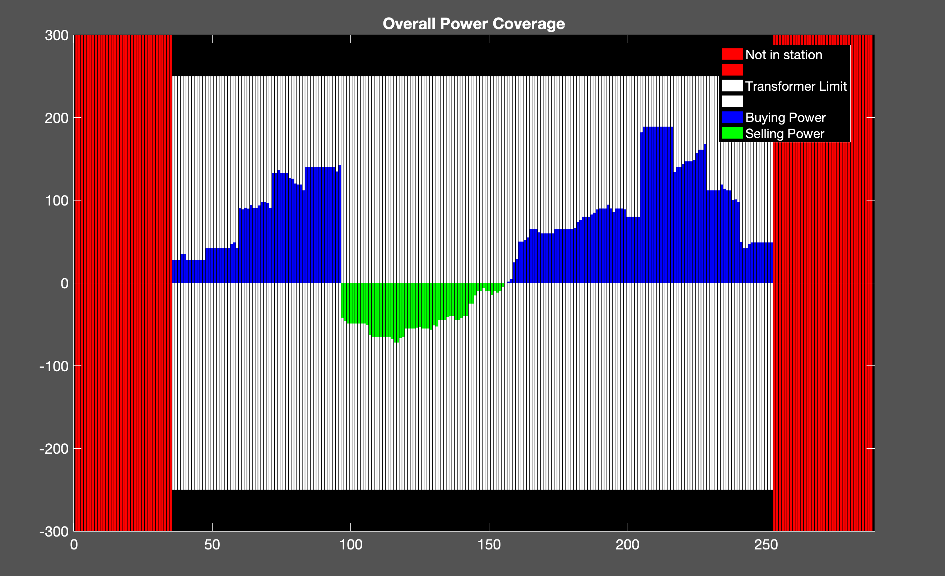
Proposed Method
50 EVs
Cost: 1.8063e+03 NT
Transformer: 250 kW

Slide 11
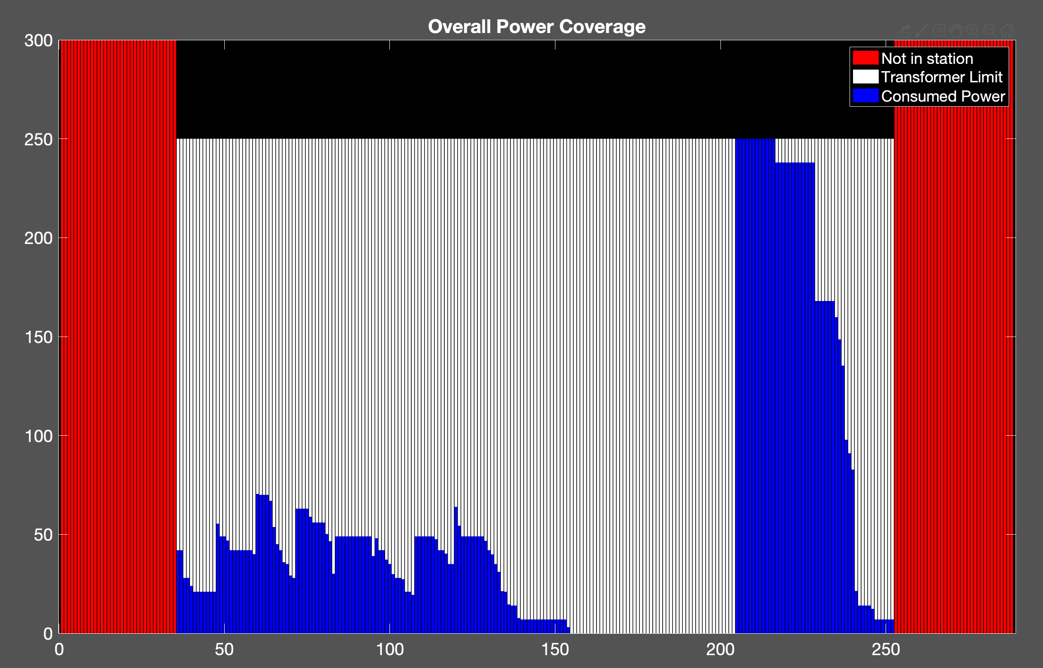
Uncoordinated Charging
50 EVs
Cost: 1.9910e+03 NT
Transformer: 250 kW

Slide 12
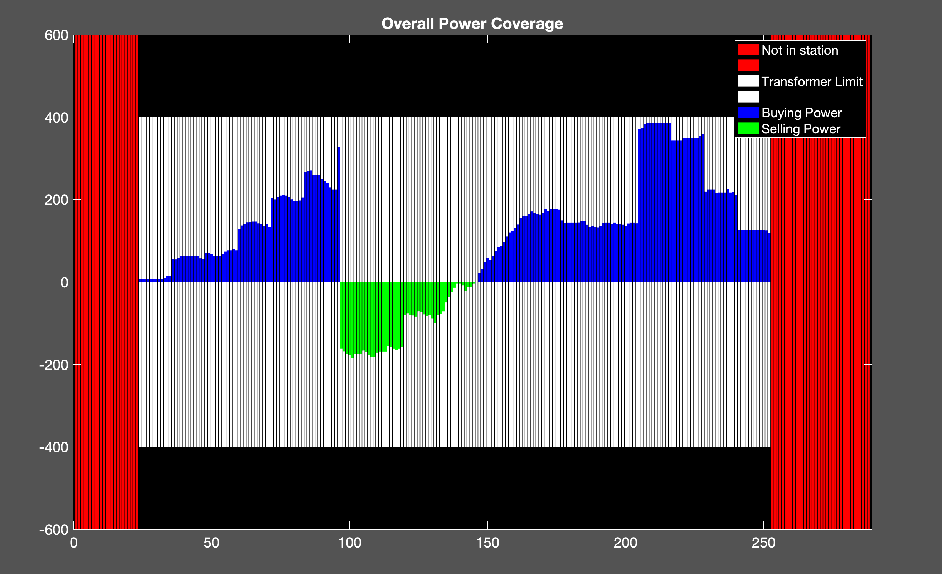
Proposed Method
100 EVs
Cost: 3.8806e+03NT
Transformer: 400kW

Slide 13
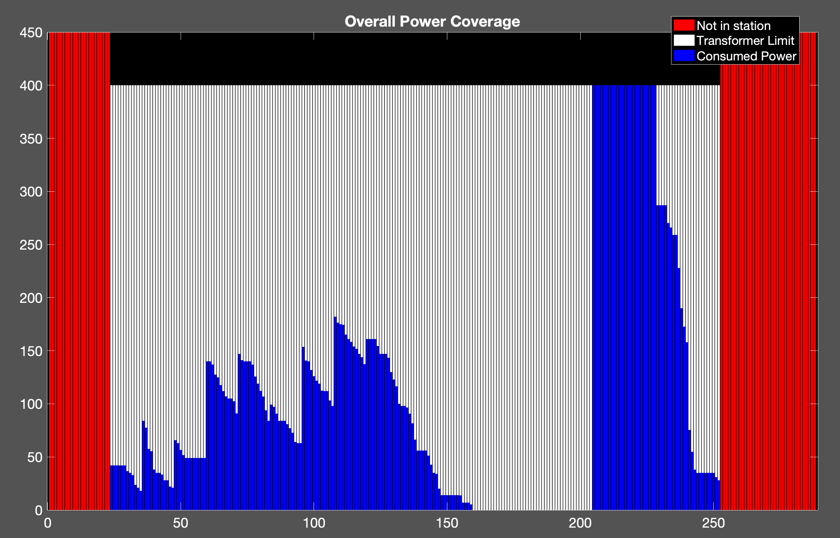
Uncoordinated Charging
100 EVs
Cost: 4.4808e+03 NT
Transformer: 400kW

Slide 14
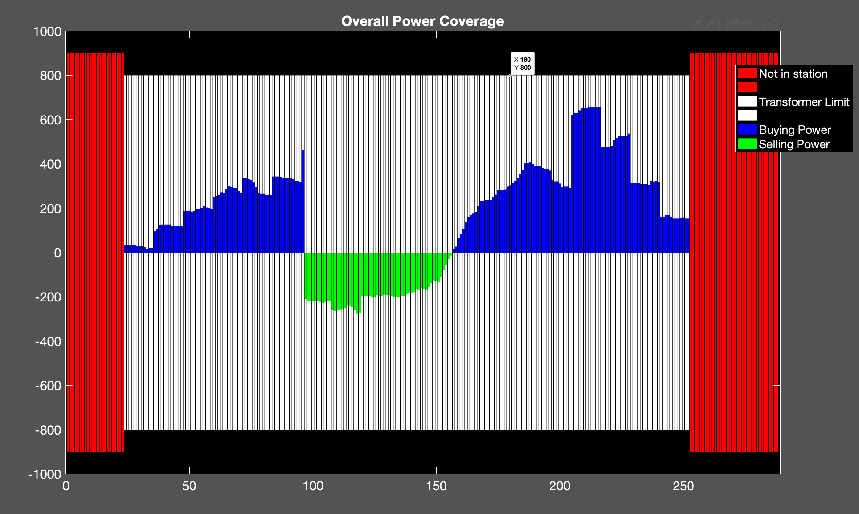
Proposed Method
150 EVs
Cost: 5.4451e+03 NT
Transformer : 800 kW

Slide 15
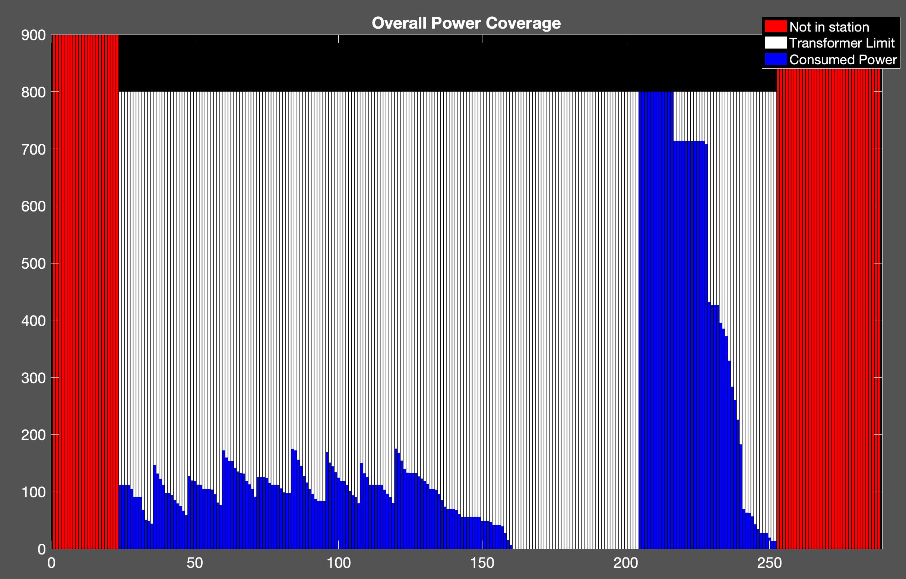
Uncoordinated Charging
150 EVs
Cost: 6.1406e+03 NT
Transformer : 800 kW

Slide 16
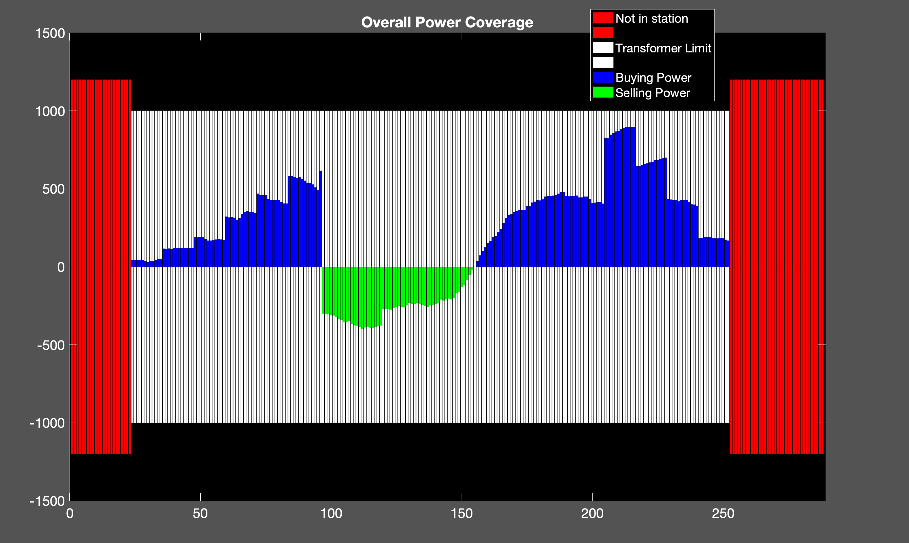
Proposed Method
200 EVs
cost: 7.1510e+03 NT
Transformer : 1000 kW

Slide 17
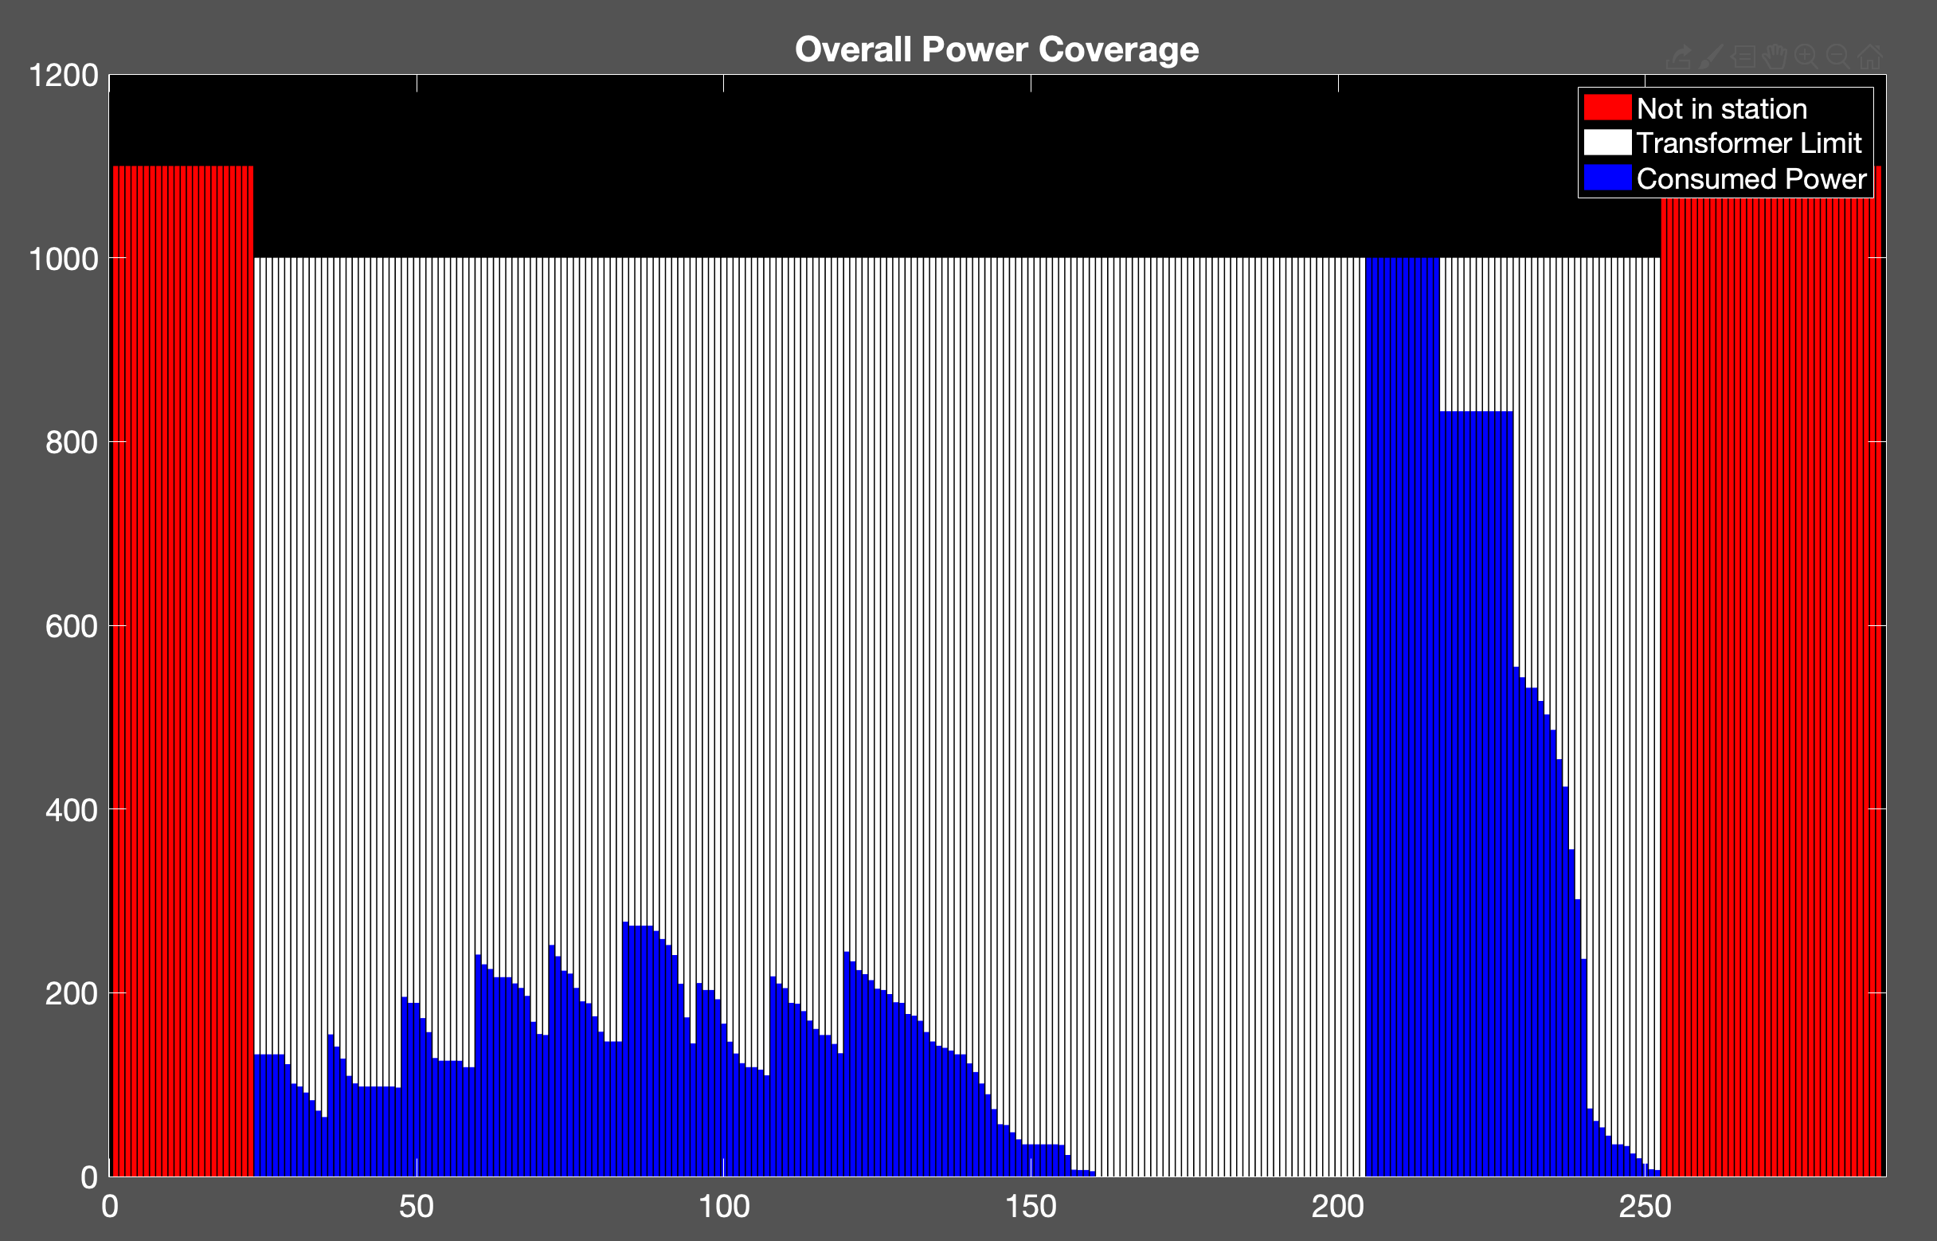
Uncoordinated Charging
200 EVs
Cost: 8.1726e+03 NT
Transformer : 1000 kW

Slide 18
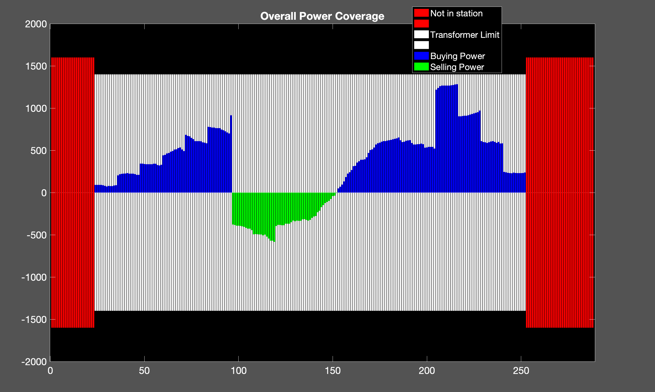
Proposed Method
300 EVs
Cost: 1.1187e+04 NT
Transformer: 1400 kW

Slide 19
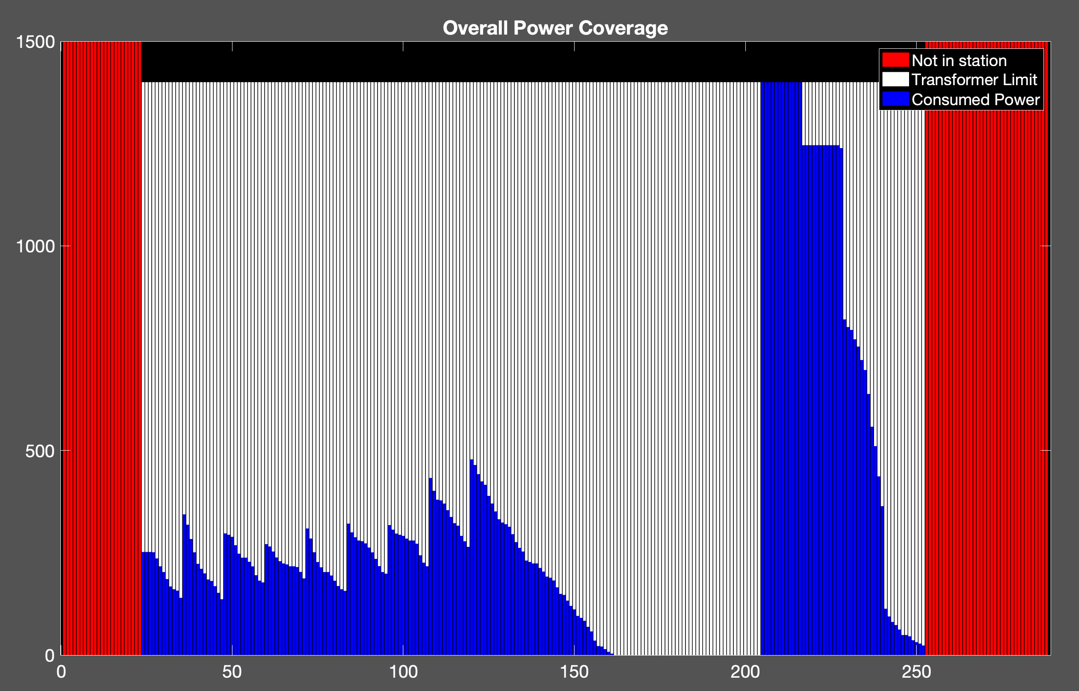
Uncoordinated Charging
300 EVs
Cost: 1.2872e+04 NT
Transformer: 1400 kW

Slide 20
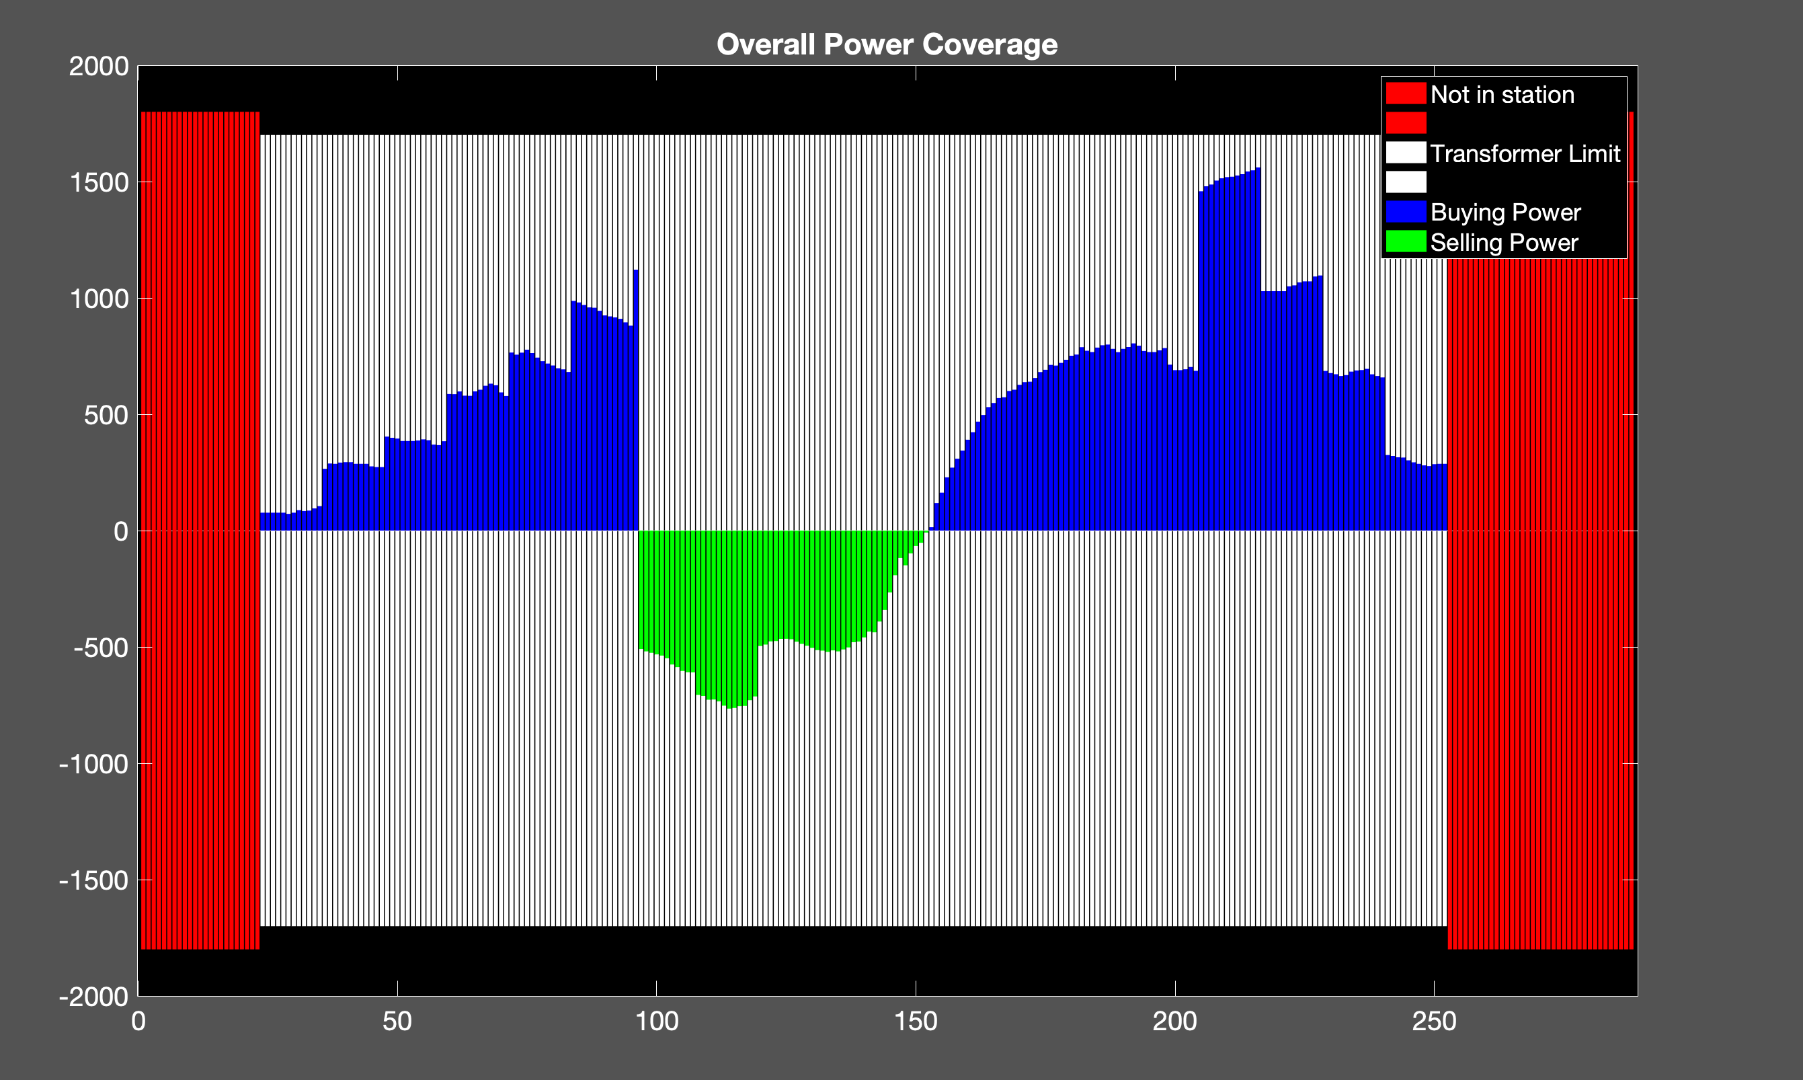
Proposed Method
350 EVs
Cost: 1.2651e+04 NT
Transformer: 1700 kW

Slide 21
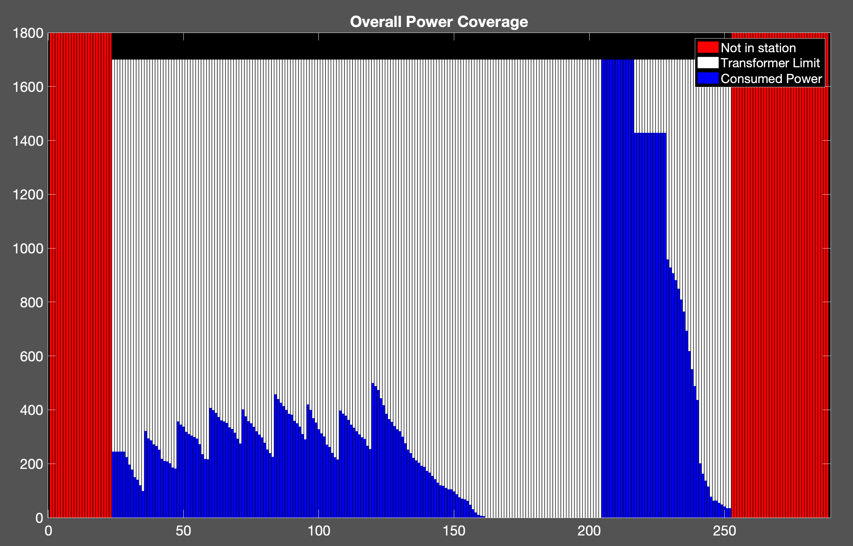
Uncoordinated Charging
350 EVs
Cost: 1.4445e+04
Transformer: 1700 kW

Slide 22
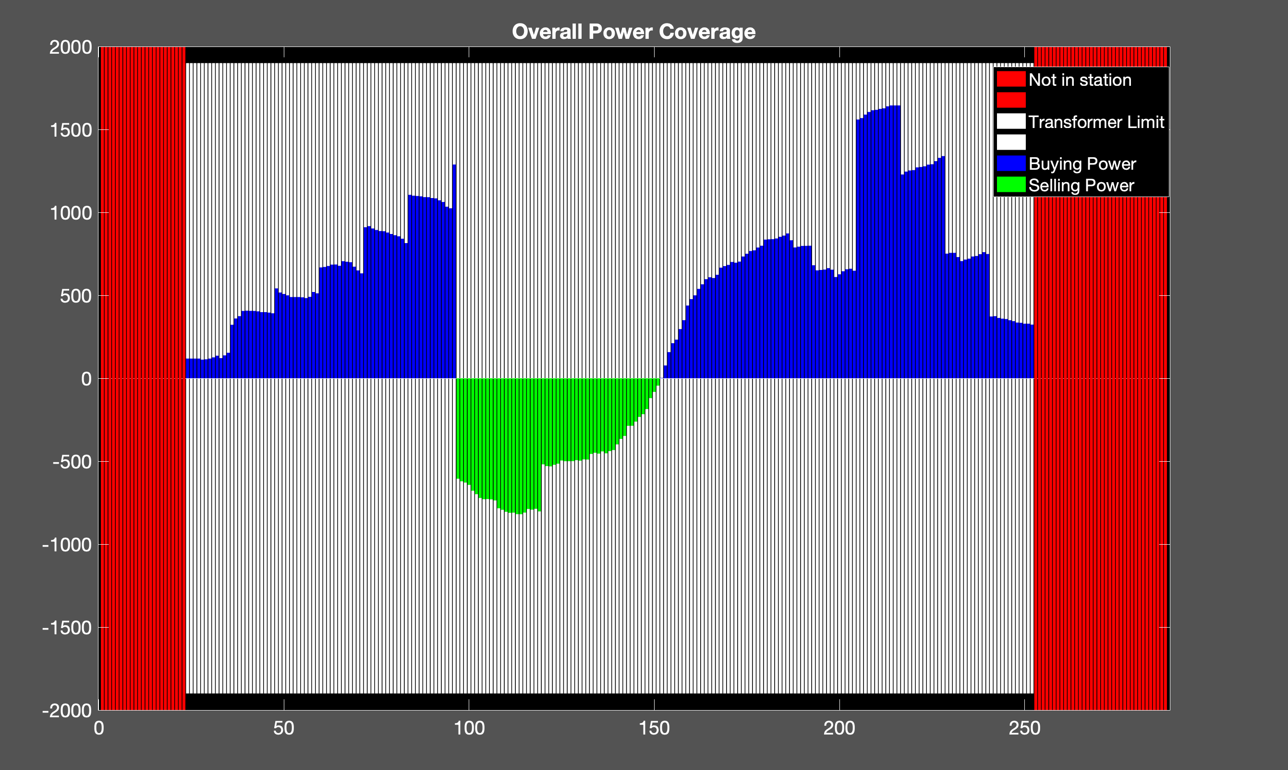
Proposed Method
400 EVs
Cost: 1.4271e+04 NT
Transformer: 1900 kW

Slide 23
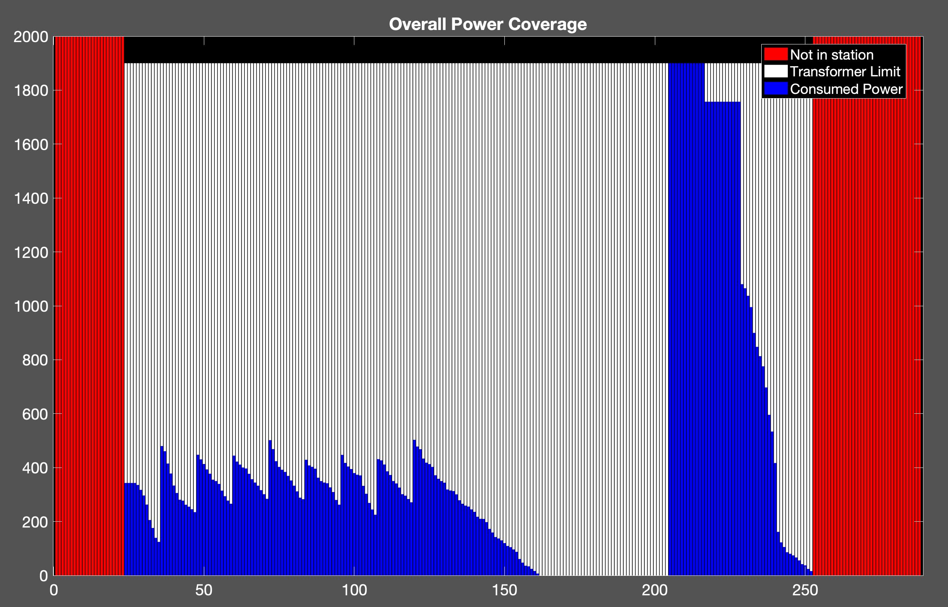
Uncoordinated Charging
400 EVs
Cost: 1.6493e+04 NT
Transformer: 1900 kW

Slide 24
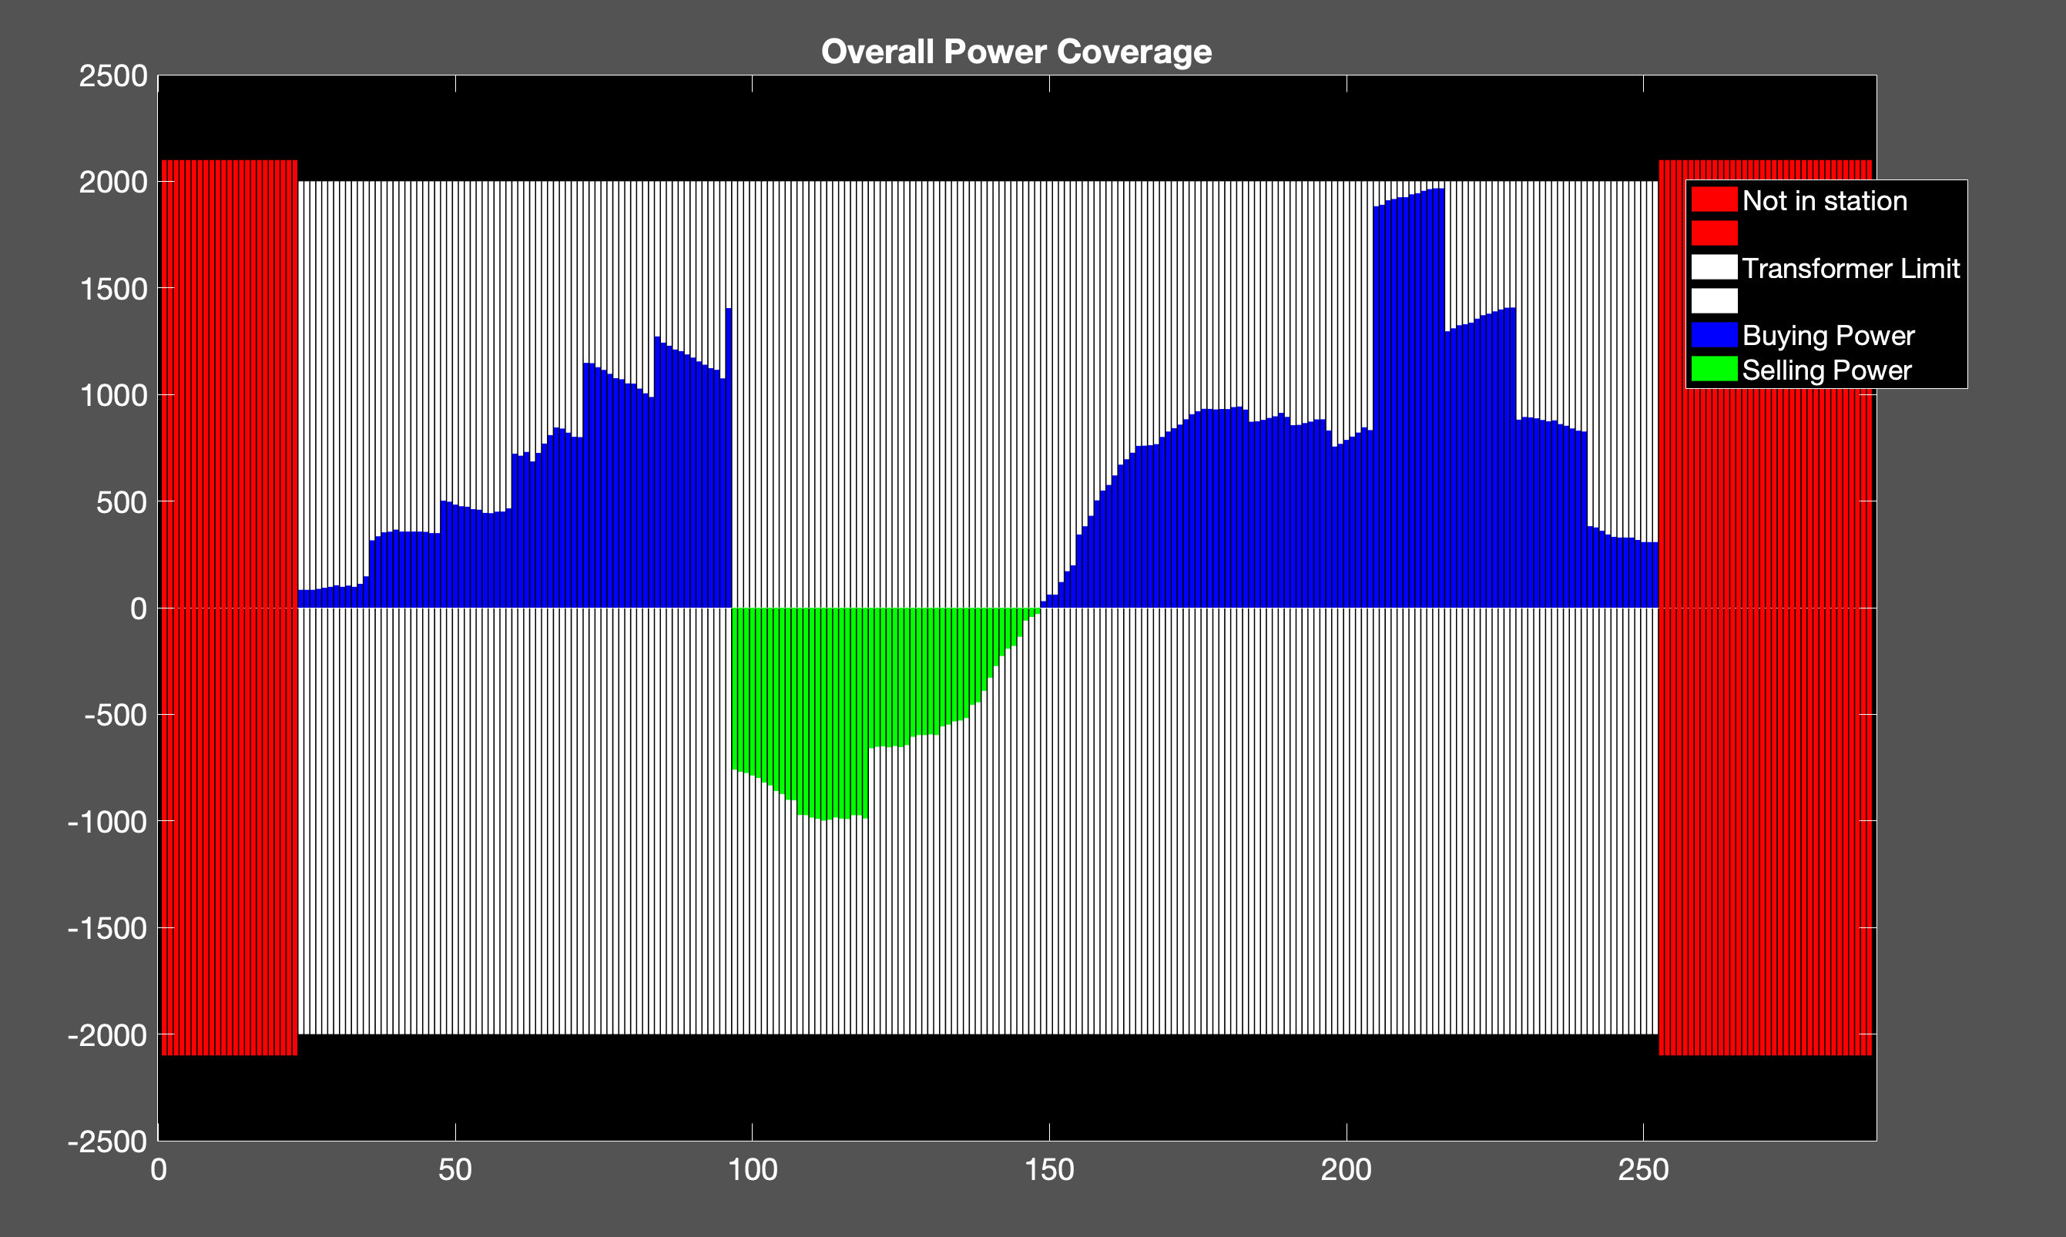
Proposed Method
450 EVs
Transformer: 2000 kW
Cost: 1.6563e+04 NT

Slide 25
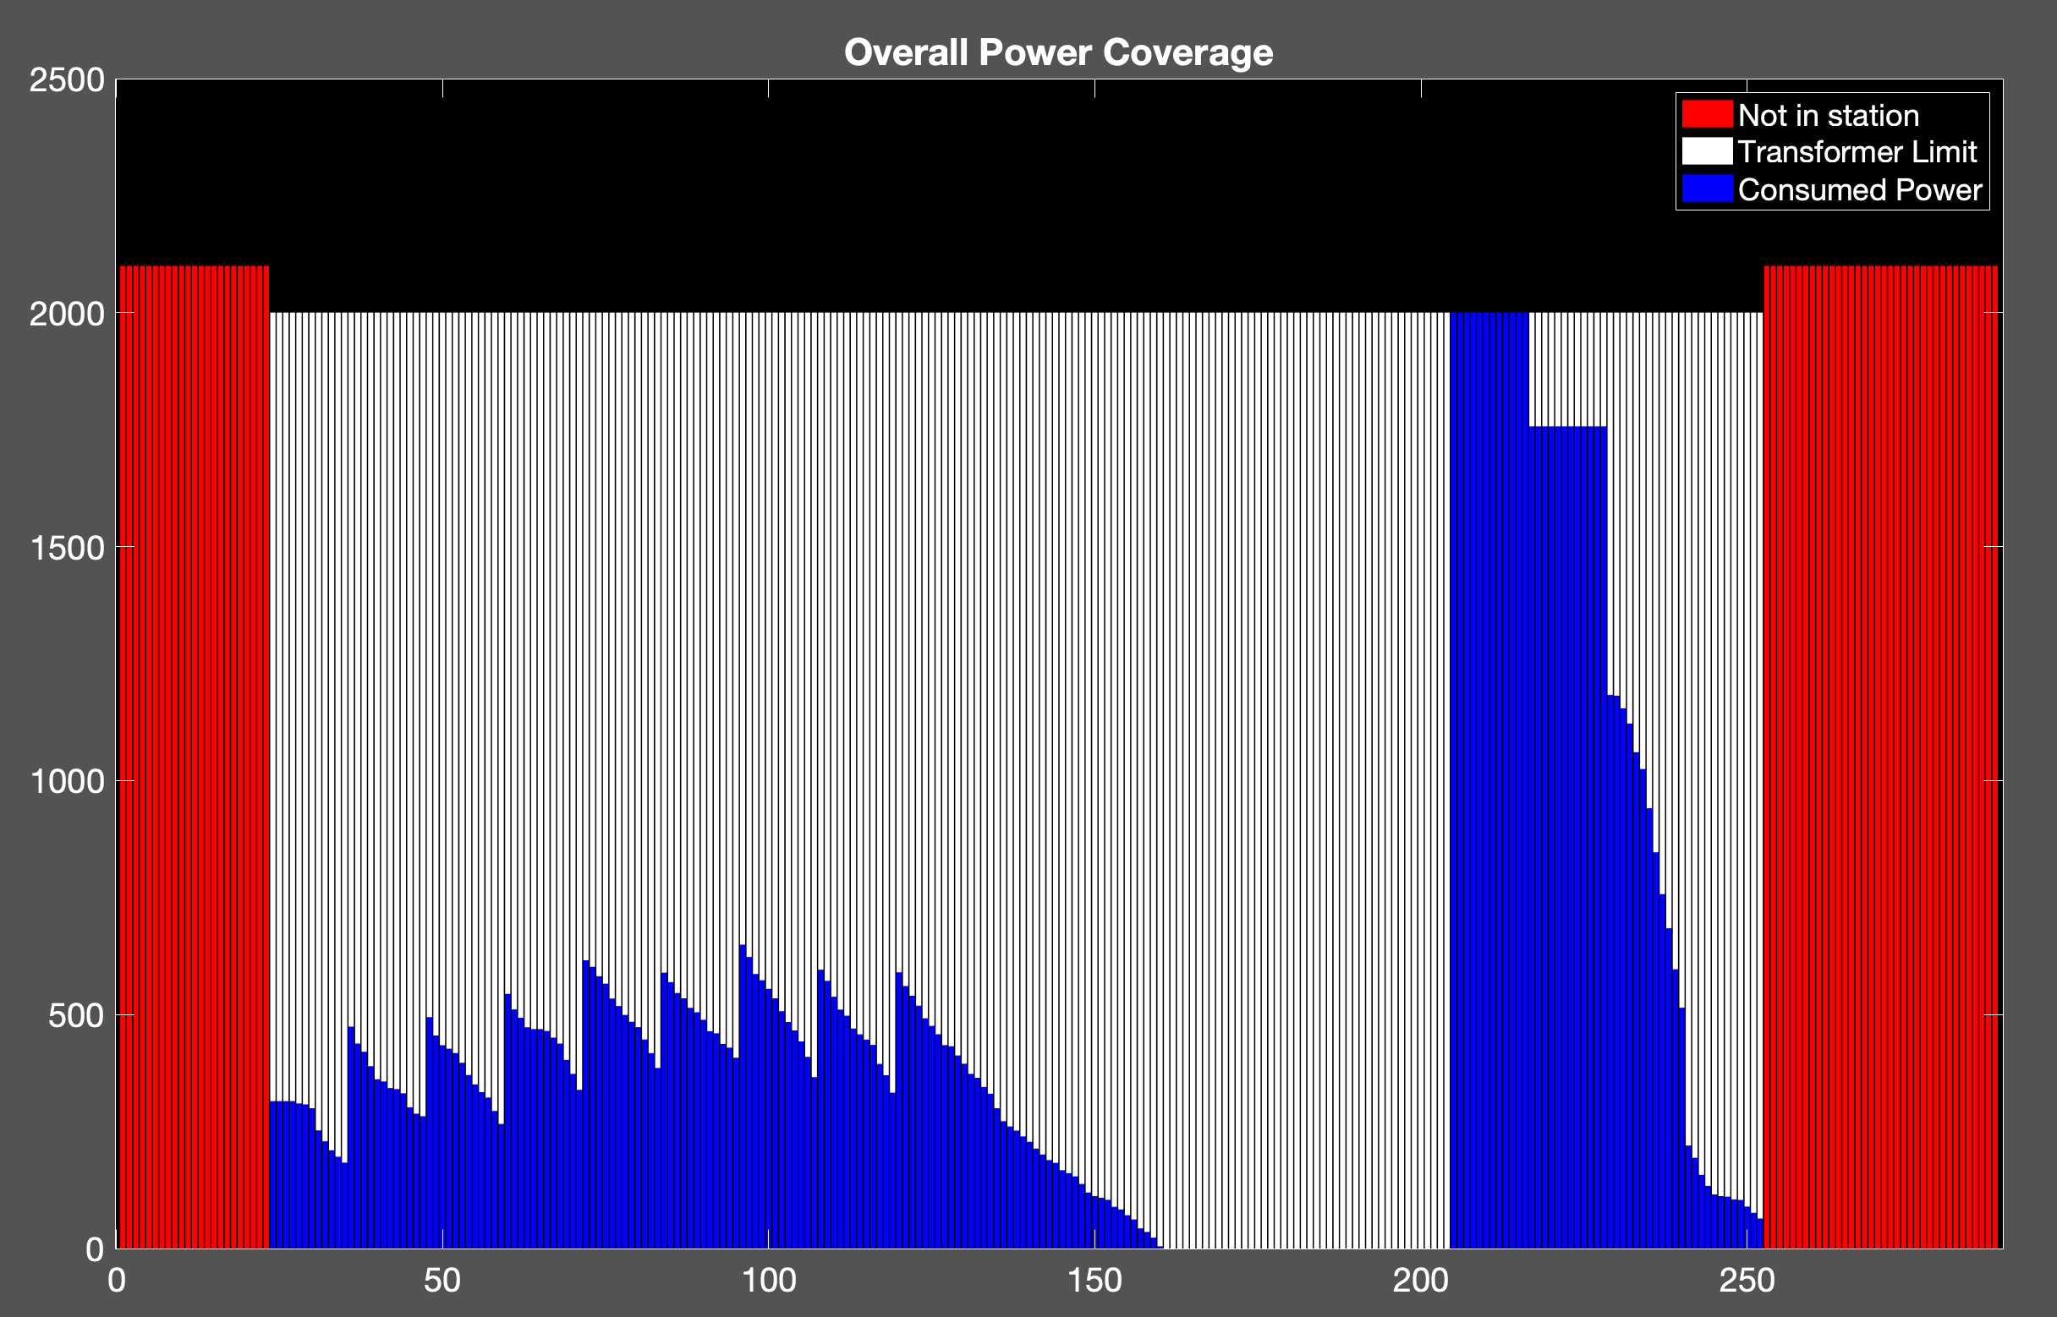
Uncoordinated Charging
450 EVs
Cost: 1.8932e+04 NT
Transformer: 2000 kW

Slide 26
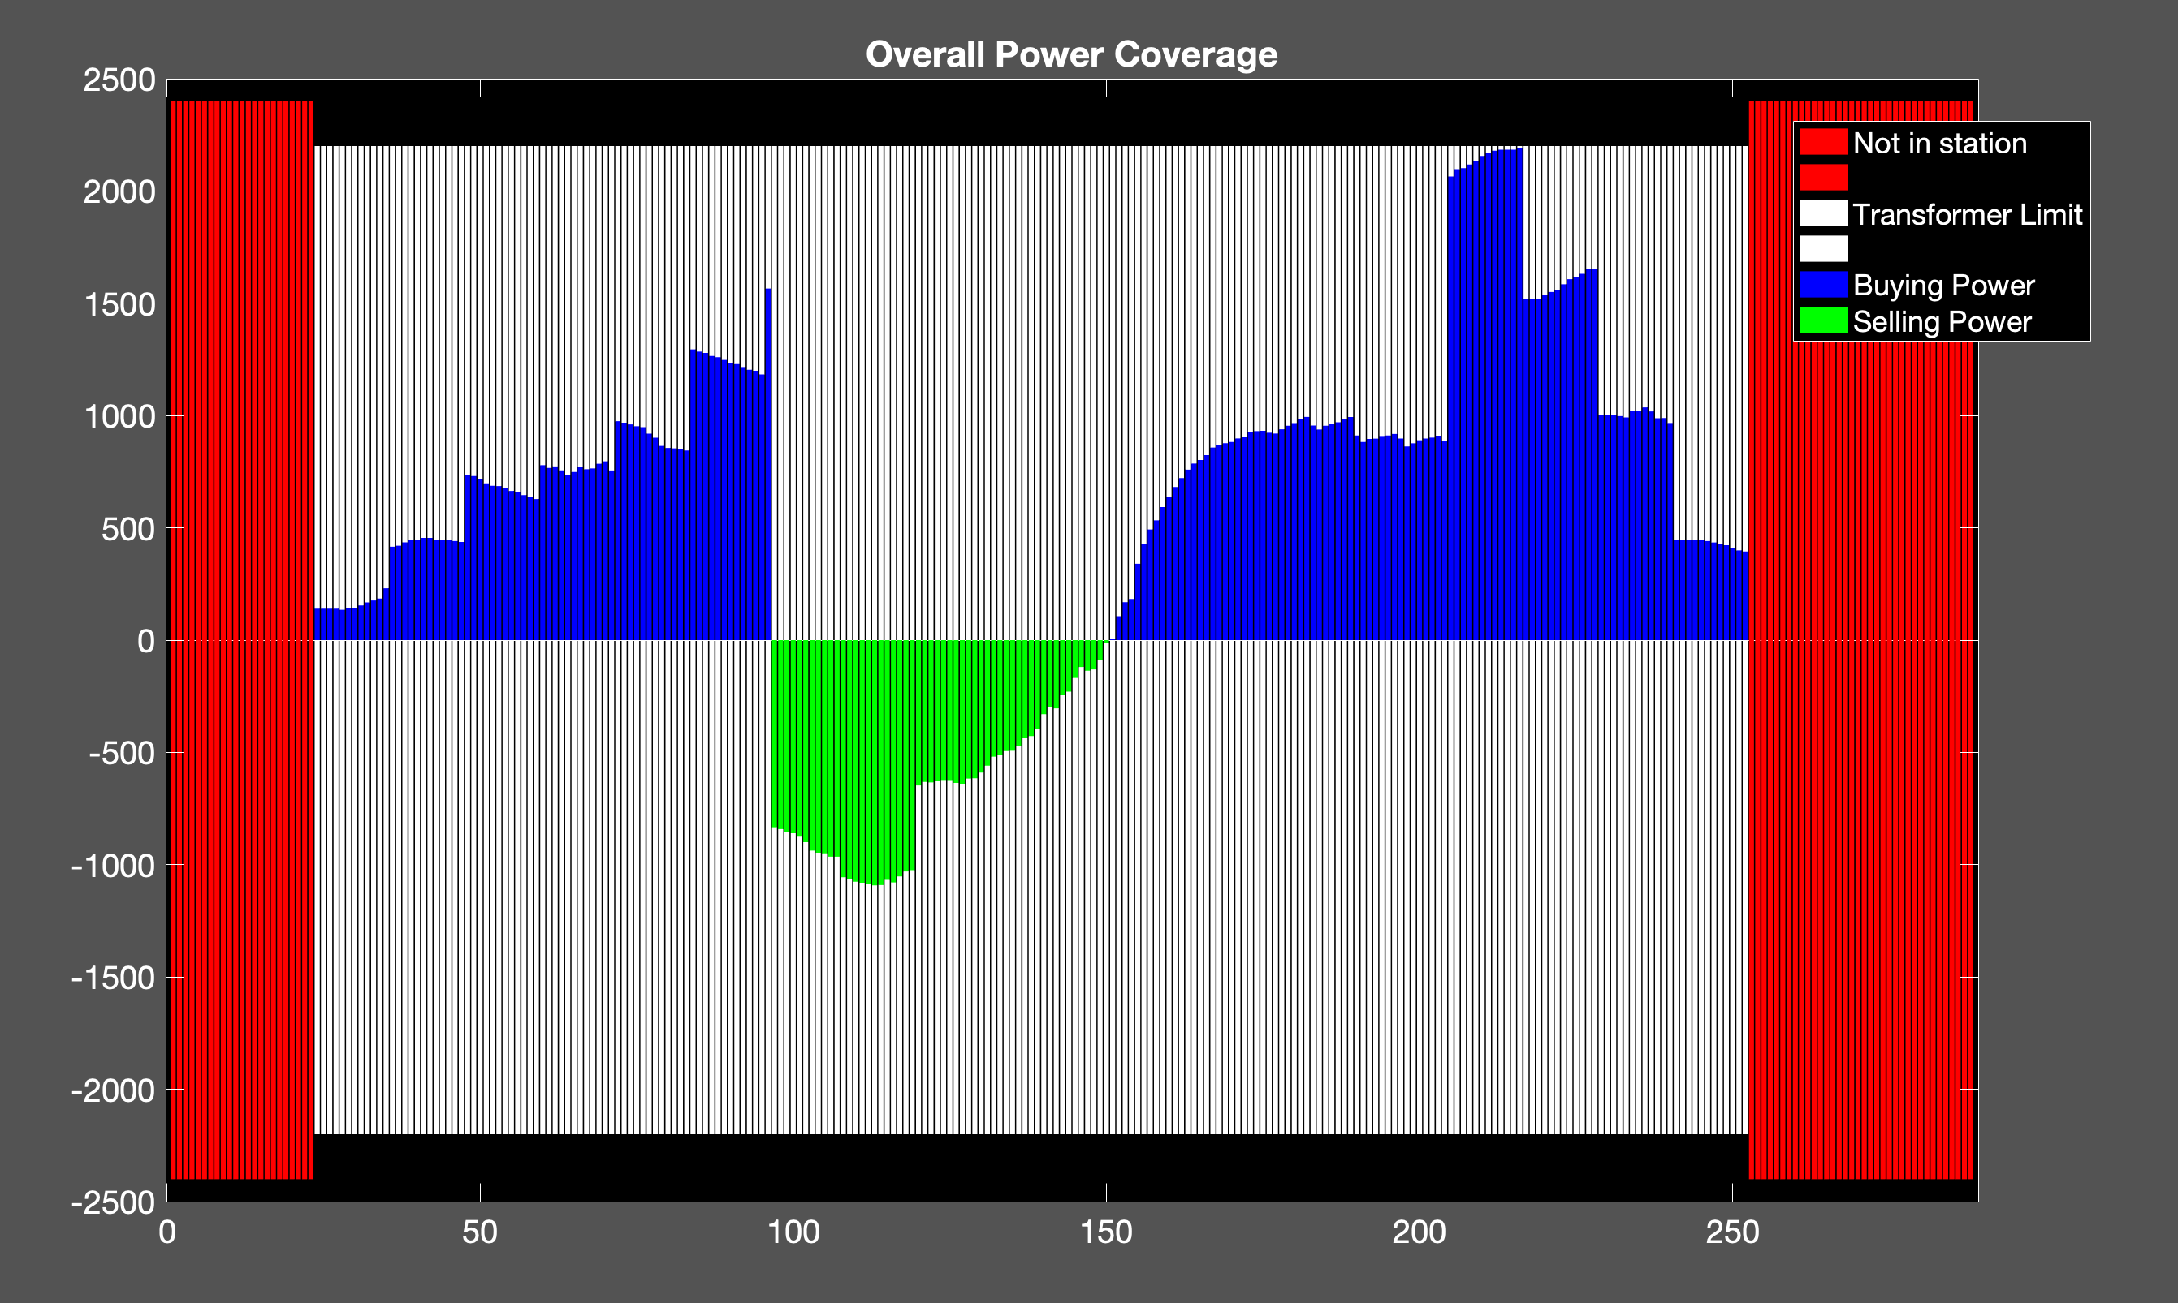
Proposed Method
500 EVs
Cost: 1.8190e+04 NT
Transformer: 2000 kW

Slide 27
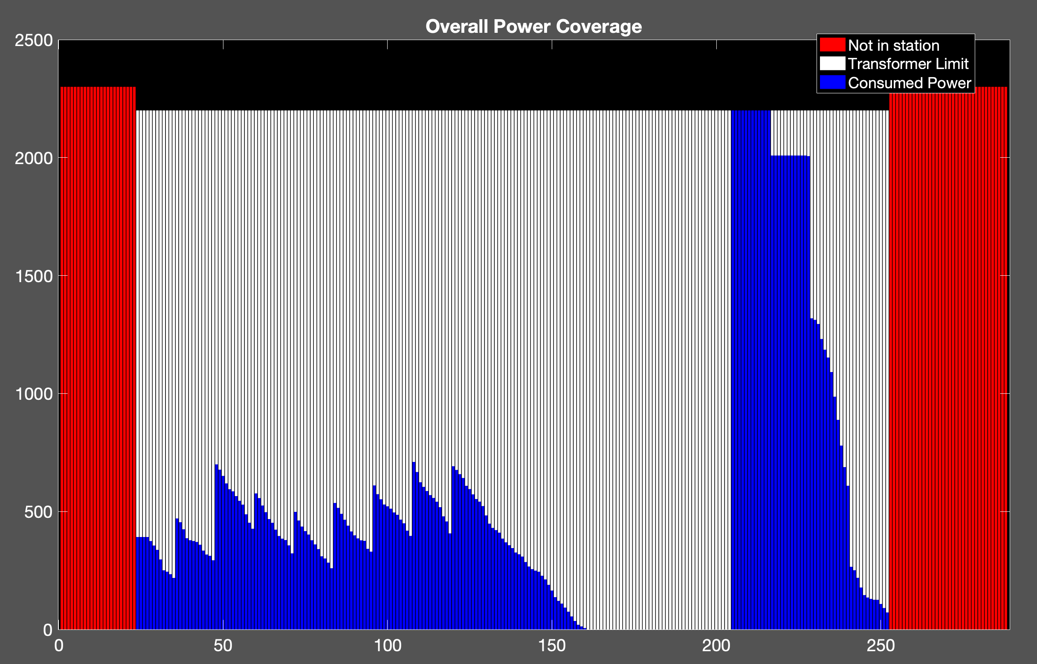
Uncoordinated Charging
500 EVs
Cost: 2.1169e+04 NT
Transformer: 2000 kW

Slide 28
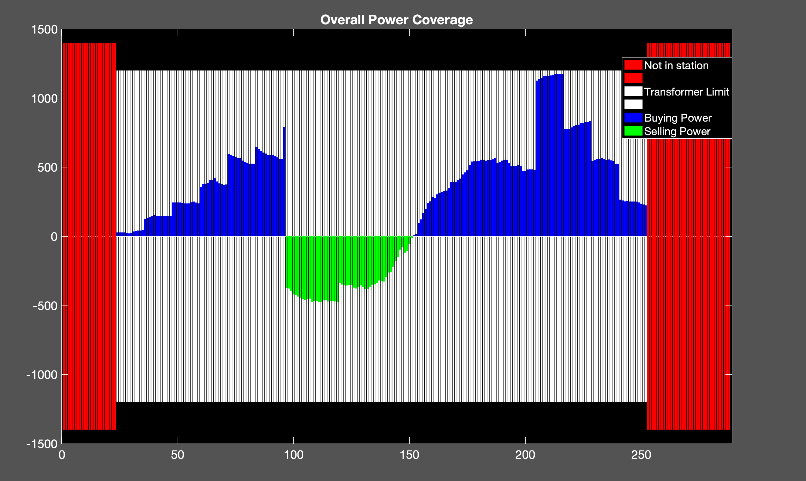
Proposed Method
250 EVs
Cost: 9.0239e+03
Transformer:1200kW

Slide 29
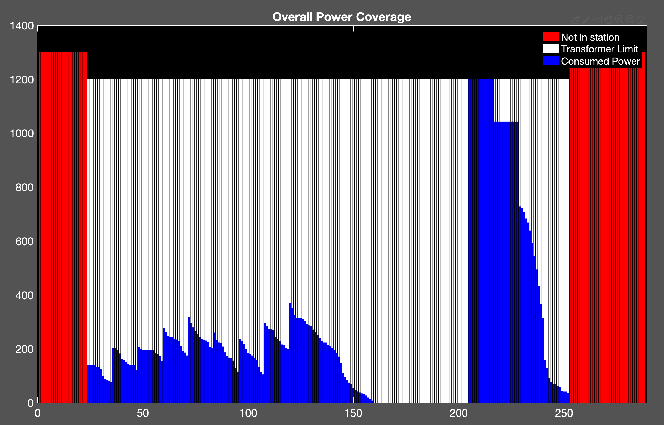
Uncoordinated Charging
250 EVs
Cost: 1.0485e+04 NT
Transformer:1200kW

Slide 30
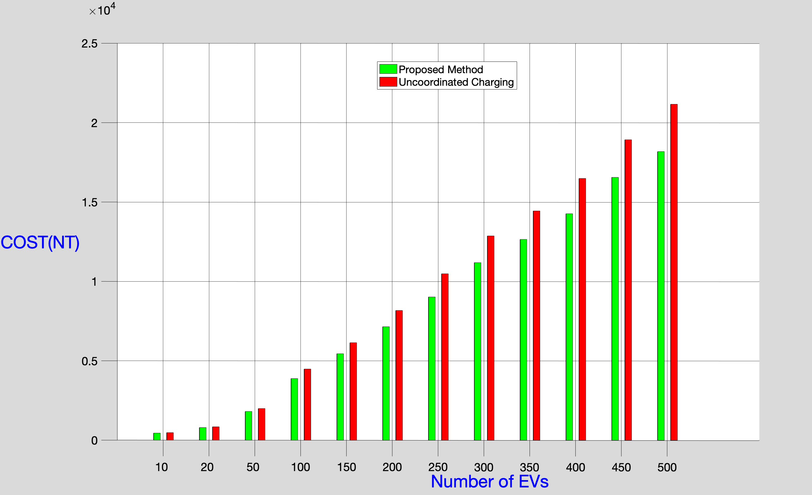
Comparative Plot

